Slide 1

Pattern Classification
All materials in these slides were taken from
Pattern Classification (2nd ed) by R. O. Duda, P. E. Hart and D. G. Stork, John Wiley & Sons, 2000
with the permission of the authors and the publisher

Slide 2
Course Outline
MODEL INFORMATION
COMPLETE
INCOMPLETE
Bayes Decision Theory
Supervised Learning
Unsupervised Learning
Parametric Approach
Nonparametric Approach
Parametric Approach
Nonparametric Approach
“Optimal” Rules
Plug-in Rules
Density Estimation
Geometric Rules (K-NN, MLP)
Mixture Resolving
Cluster Analysis (Hard, Fuzzy)

Slide 3
Chapter 3:
Maximum-Likelihood & Bayesian Parameter Estimation (part 1)
Introduction
Maximum-Likelihood Estimation
  Example of a Specific Case
  The Gaussian Case: unknown μ and σ
  Bias
Appendix: ML Problem Statement

Slide 4
Introduction
  Data availability in a Bayesian framework
    We could design an optimal classifier if we knew:
      P(ω_{i}) (priors)
      P(x | ω_{i}) (class-conditional densities)
    Unfortunately, we rarely have this complete information!
  Design a classifier from a training sample
    No problem with prior estimation
    Samples are often too small for class-conditional estimation (large dimension of feature space!)
Pattern Classification, Chapter 3
1

Slide 5
  A priori information about the problem
    Do we know something about the distribution?
    → find parameters to characterize the distribution
  Example: Normality of P(x | ω_{i})
    P(x | ω_{i}) ~ N( μ_{i}, Σ_{i})
    Characterized by 2 parameters
  Estimation techniques
    Maximum-Likelihood (ML) and the Bayesian estimations
    Results are nearly identical, but the approaches are different
Pattern Classification, Chapter 3
1

Slide 6
    Parameters in ML estimation are fixed but unknown!
      Best parameters are obtained by maximizing the probability of obtaining the samples observed
    Bayesian methods view the parameters as random variables having some known distribution
    In either approach, we use P(ω_{i} | x)
    for our classification rule!
Pattern Classification, Chapter 3
1

Slide 7
Maximum-Likelihood Estimation
    Has good convergence properties as the sample size increases
    Simpler than any other alternative techniques
  General principle
    Assume we have c classes and
    P(x | ω_{j}) ~ N( μ_{j}, Σ_{j})
    P(x | ω_{j}) ≡ P (x | ω_{j}, θ_{j}) where:
Pattern Classification, Chapter 3
2

Slide 8
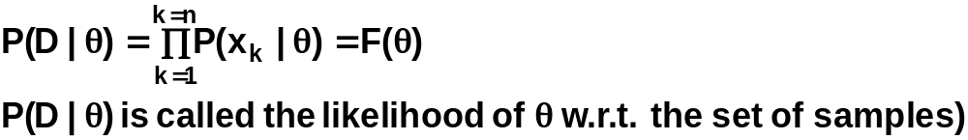

    Use the information
    provided by the training samples to estimate
    θ = (θ₁, θ₂, …, θ_{c}), each θ_{i} (i = 1, 2, …, c) is associated with each category
    Suppose that D contains n samples, x₁, x₂,…, x_{n}
    ML estimate of θ is, by definition the value that maximizes P(D | θ)
    “It is the value of θ that best agrees with the actually observed training sample”
Pattern Classification, Chapter 3
2

Slide 9
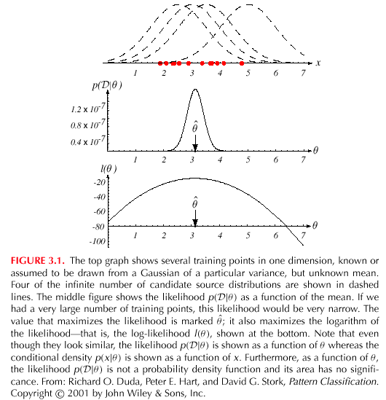
Pattern Classification, Chapter 3
2

Slide 10
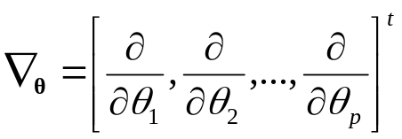
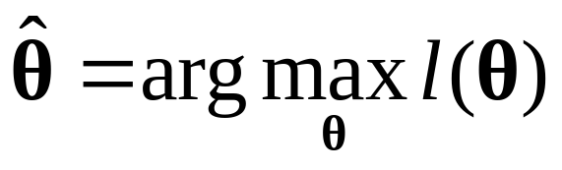
    Optimal estimation
      Let θ = (θ₁, θ₂, …, θ_{p})^{t} and let ∇_{θ} be the gradient operator
      We define l(θ) as the log-likelihood function
      l(θ) = ln P(D | θ)
      (recall D is the training data)
      New problem statement:
      determine θ that maximizes the log-likelihood
Pattern Classification, Chapter 3
2

Slide 11
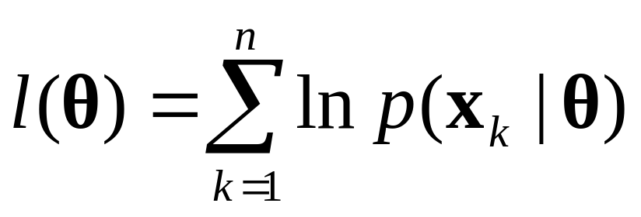
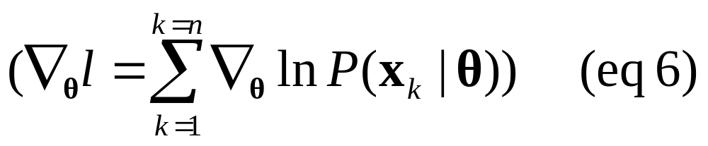
    The definition of l() is:
    and
    Set of necessary conditions for an optimum is:
    ∇_{θ}l = 0 (eq. 7)
Pattern Classification, Chapter 3
2

Slide 12
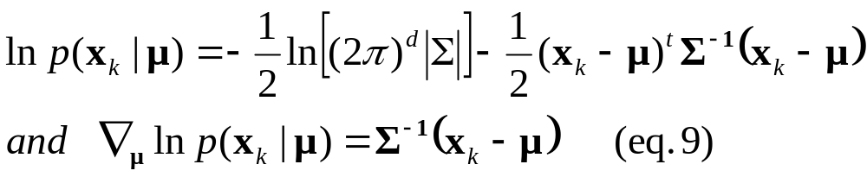
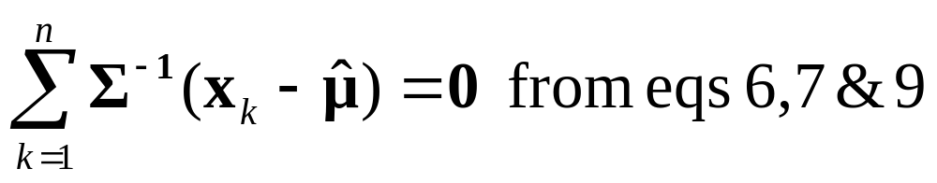
Example, the Gaussian case: unknown μ
  We assume we know the covariance
  p(x_{i} | μ) ~ N(μ, Σ)
  (Samples are drawn from a multivariate normal population)
  θ = μ therefore:
  The ML estimate for μ must satisfy:
Pattern Classification, Chapter 3
2

Slide 13
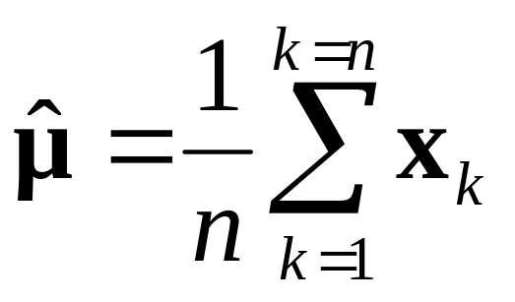
    Multiplying by Σ and rearranging, we obtain:
    Just the arithmetic average of the samples of the training samples!
    Conclusion:
    If P(x_{k} | ω_{j}) (j = 1, 2, …, c) is supposed to be Gaussian in a d-dimensional feature space; then we can estimate the vector
    θ = (θ₁, θ₂, …, θ_{c})^{t} and perform an optimal classification!
Pattern Classification, Chapter 3
2

Slide 14
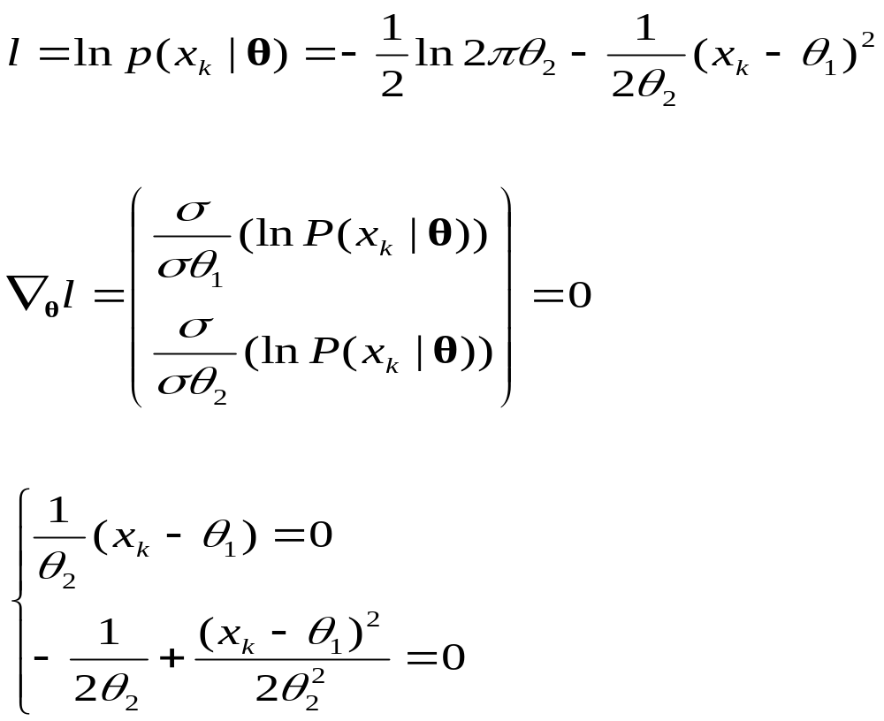
Example, Gaussian Case: unknown μ and Σ
  First consider univariate case: unknown μ and σ
  θ = (θ₁, θ₂) = (μ, σ²)
Pattern Classification, Chapter 3
2

Slide 15
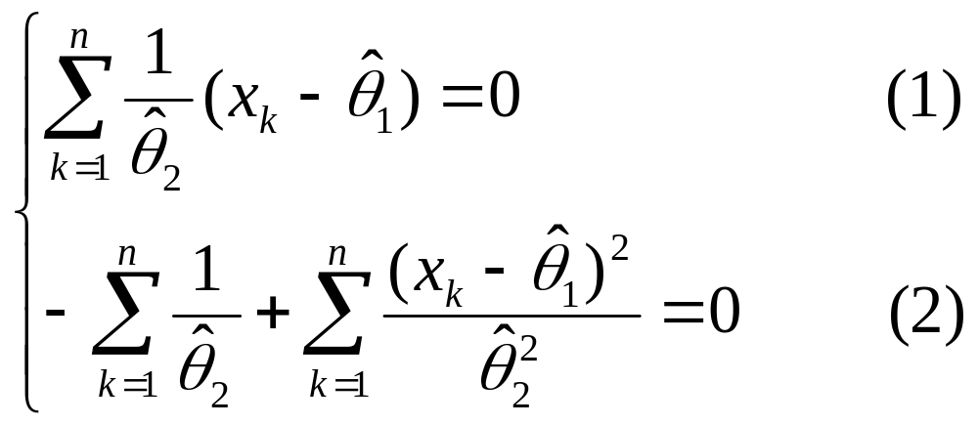
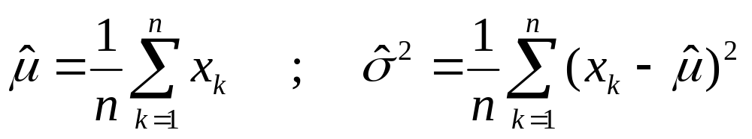
Summation (over the training set):
Combining (1) and (2), one obtains:
Pattern Classification, Chapter 3
2

Slide 16
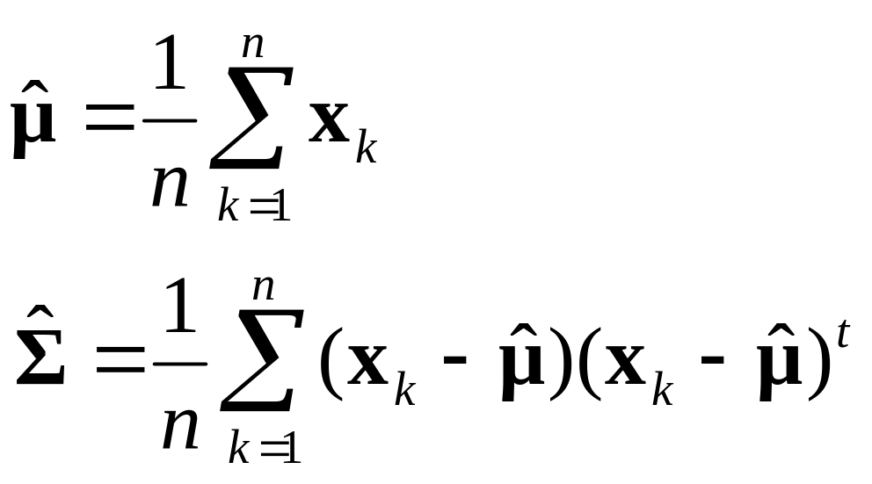
The ML estimates for the multivariate case is similar
  The scalars χ and μ are replaced with vectors
  The variance σ² is replaced by the covariance matrix
Pattern Classification, Chapter 3

Slide 17
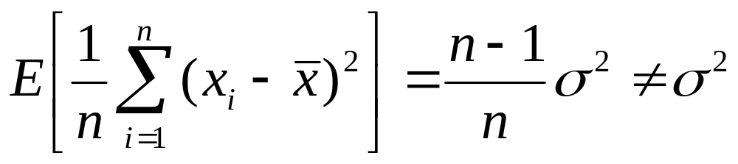
Bias
  ML estimate for σ² is biased
  Extreme case: n=1, E[ ] = 0 ≠ σ²
  As the n increases the bias is reduced
  → this type of estimator is called asymptotically unbiased
Pattern Classification, Chapter 3
2

Slide 18
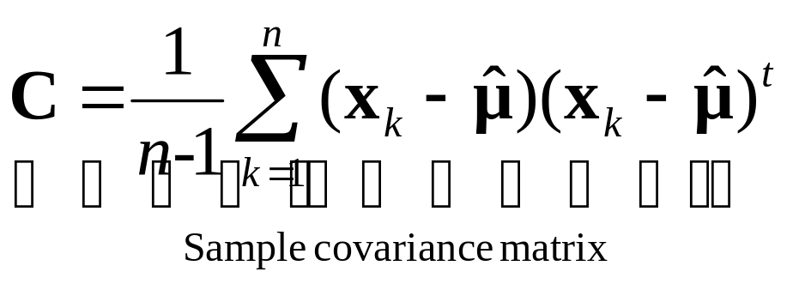
  An elementary unbiased estimator for Σ is:
  This estimator is unbiased for all distributions
  → Such estimators are called absolutely unbiased
Pattern Classification, Chapter 3
2

Slide 19
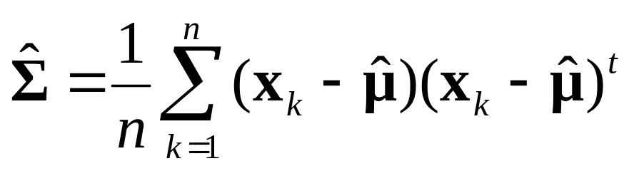
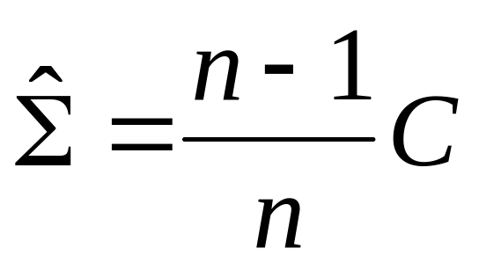
  Our earlier estimator for Σ is biased:
  In fact it is asymptotically unbiased:
  Observe that
Pattern Classification, Chapter 3
2

Slide 20
Appendix: ML Problem Statement
  Let D = {x₁, x₂, …, x_{n}}
  P(x₁,…, x_{n} | θ) = Π^{1,n}P(x_{k} | θ); |D| = n
  Our goal is to determine (value of θ that maximizes the likelihood of this sample set!)
Pattern Classification, Chapter 3
2

Slide 21
|D| = n
.
.
.
.
x₂
x₁
.
.
x_{n}
N(μ_{j}, Σ_{j}) = P(x_{j}, ω₁)
P(x_{j} | ω₁)
P(x_{j} | ω_{k})
D₁
x₁₁
.
.
.
.
x₁₀
.
D_{k}
D_{c}
x₈
.
.
.
x₂₀
.
.
x₁
x₉
.
.
Pattern Classification, Chapter 3
2

Slide 22
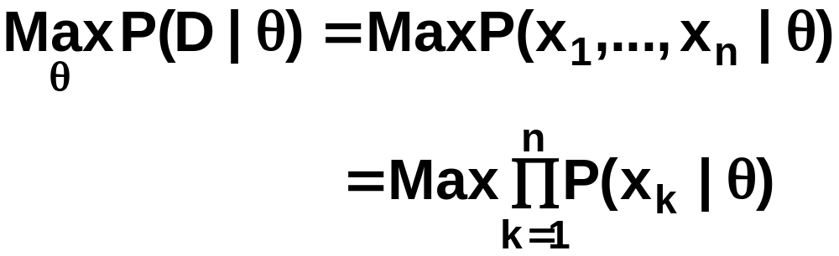
θ = (θ₁, θ₂, …, θ_{c})
Problem: find such that:
Pattern Classification, Chapter 3
2

